Slide 1

Identifying Liquids through Radiometric Effect and Deep
Networks
Team Members:
Usama Younus
Tu Luan
Arun Kumar Dhandayuthabani

Slide 2
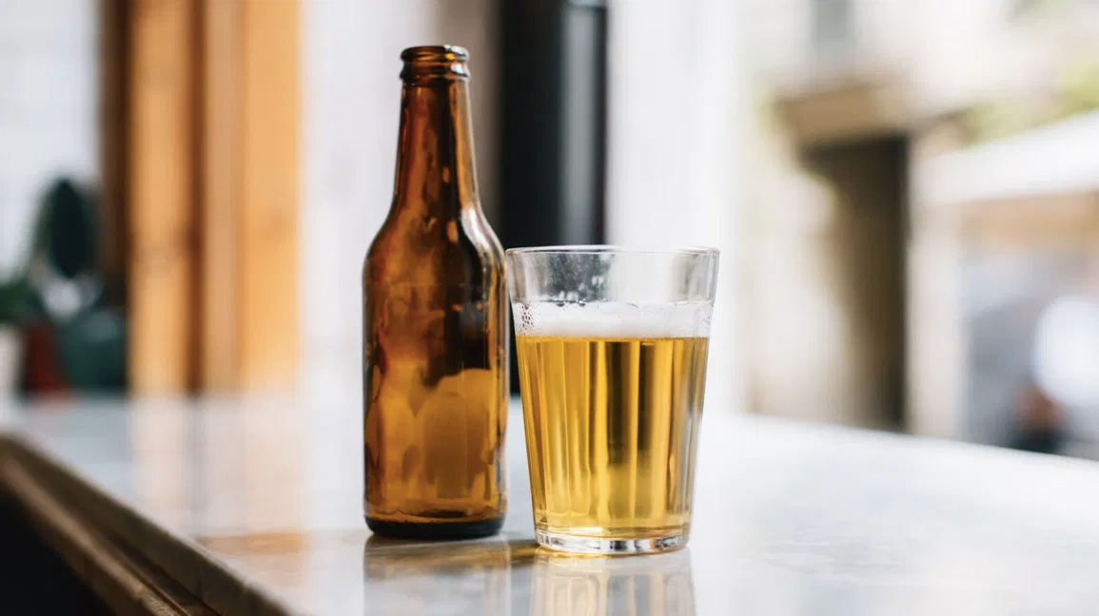
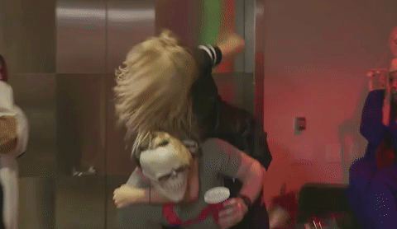


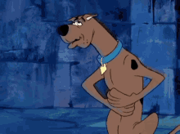
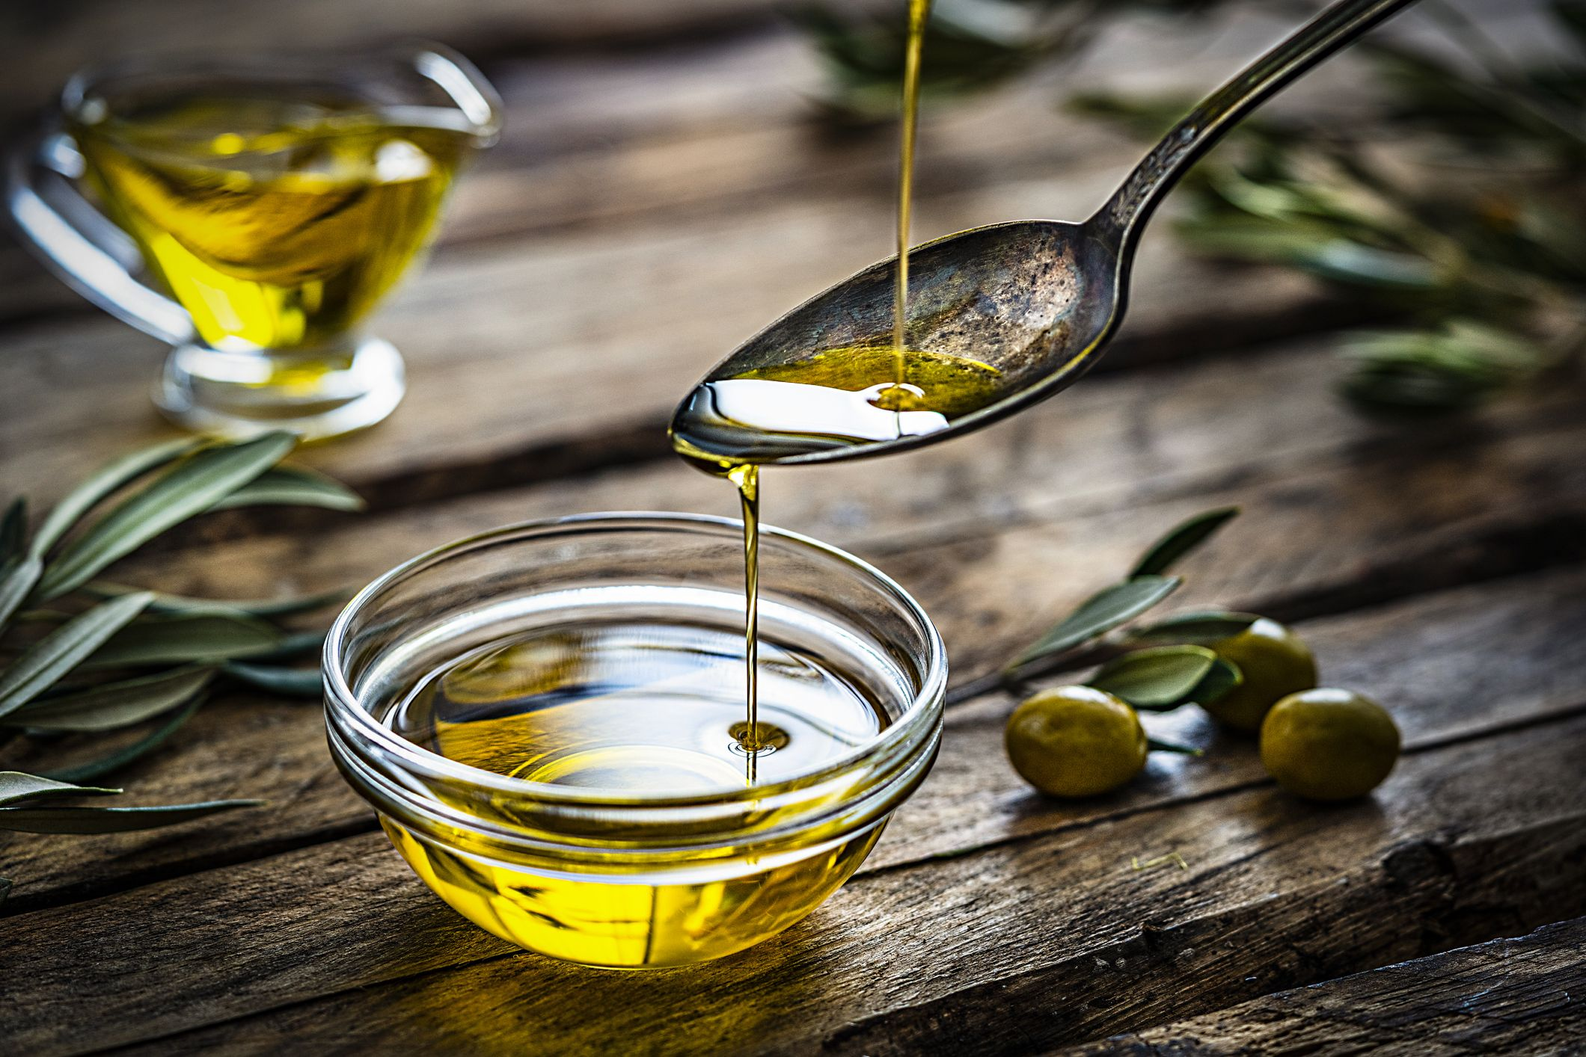
Disclaimer: Déjà vu here
Motivation
Alcohol
This
Not This
Olive Oil
Notes:
Our presentation today actually starts with the motivation behind the project: getting the outcome or the benefit of a product that you pay for in the market.
[click] For starters, let's take the example of Alcohol, when we go to buy it, we may have something of like this in mind - maybe after a lot of consumption. However we would never think that it could have this sort of an impact
[click]
Same is the scenario with olive oil. When we buy it, we consider it for its nutritious value but sometimes it can have its adverse effects

Slide 3
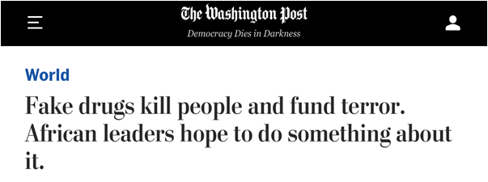
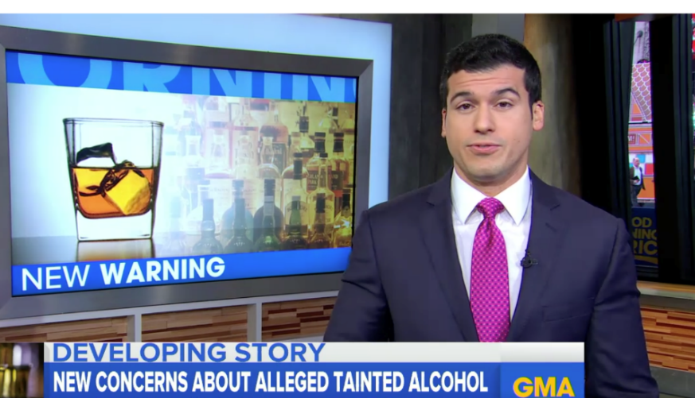
Impact Gone Wrong Globally
Déjà vu here
Notes:
SO, you may be thinking right now, that these adverse outcomes are highly unlikely in general scenarios, but the evidence speaks to the contrary.
[click] fake drugs is one of the problems that kills many people worldwide each year
[click] same is the case with alcohol, there have been instances of people getting blind and even dying from counterfeit alcohols

Slide 4
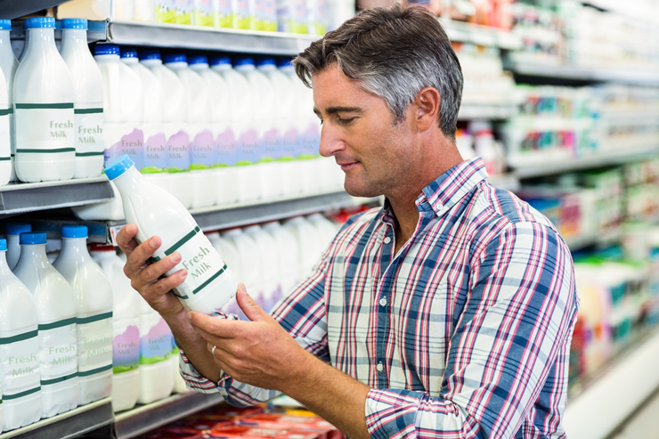
Can we sense liquids in containers?
Déjà vu here
Is it safe?
Is it authentic?
Has it expired?

Slide 5
Existing Work & Drawbacks
RF-EATS
based on Radio Frequency Identifiers(RFID)
relies on a neural learning model
achieves around 80% classification accuracy in the seven applications it tested
The transmission is a log antenna with significant size constraints.
Nutrilyzer
detects the unique spectral signatures based on photoacoustic effects of liquids.
Uses machine learning algorithms, map spectral signatures of various liquids characteristics.
Effective on milk and alcohol characterization, lack generalizability on other liquids and foods.
LiquID
Utilizes ultra-wideband(UWB) signal
Measure time of travel, phase and RSSI of the signal received to model the permittivity of liquids
The system needs to be carefully calibrated, and the resulting error rate is around 10%.
Notes:
There are multiple existing works for liquid identification and adulteration detection in this field. Today we want to talk about three of these methods.
The first one is RF-EATs.
RF-EAT is based on RFID, and it uses a neural learning model on learning Radio Frequency features on the content of a container, and remove the features in-troduced by extraneous environmental changes.
Liquid ID utilizes UWB signals, by measuring the tot, phases and RSSI of the signal received, it models the permittivity of liquids, and the through the unique permittivity, it was able to identify the liquids.

Slide 6
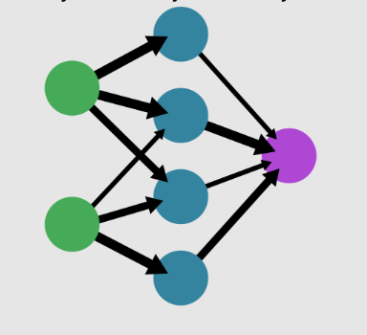
Proposed Solution
transmitting and scattering
training neural network models
Liquids
Sensors
LEDs
Multiclass Classification
measure the signal attenuation
Notes:
Here is our proposed working solution that we experimented with: The LEDs emits light which is scattered and transmitted through the liquid and the surrounding closed environment.The color sensor measures the signal attenuation.With the obtained sensor values,we train a neural network to perform multiclass classification to distinguish between different liquids tested in our approach.

Slide 7
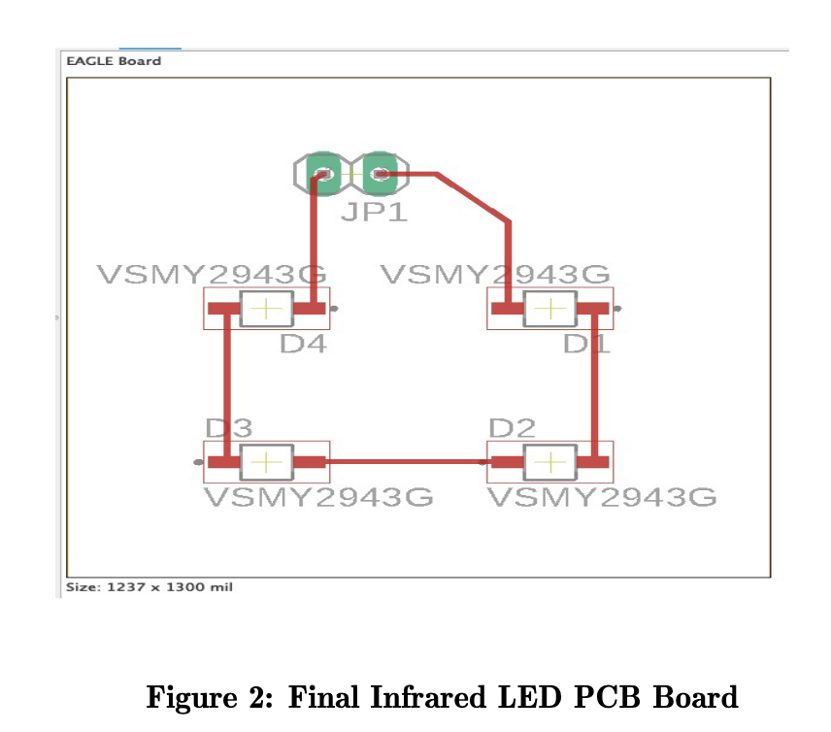
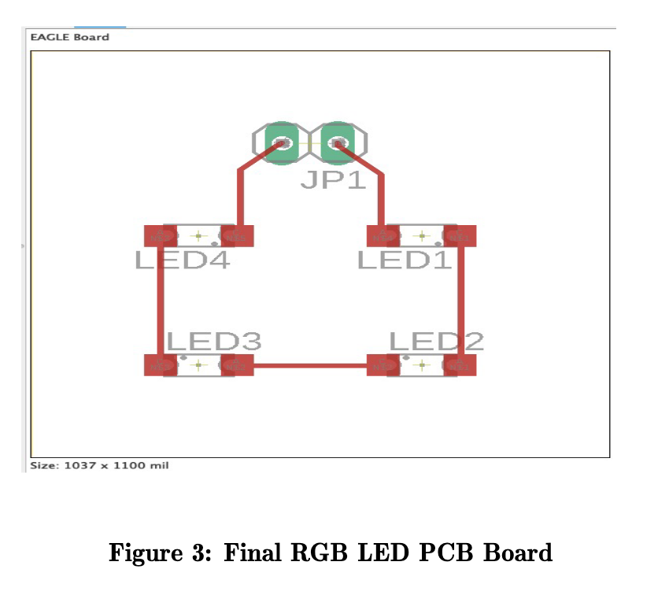
Circuit Design
Notes:
Our custom designed LED panels were designed on Eagle AutoDesk Fusion 360.We tried a couple of design choices but the above design was the most effective due to the cost and size.Here the LEDs are connected in series to each other.4 LED panels were constructed:Green,Blue,Red and Infrared LED panels.

Slide 8
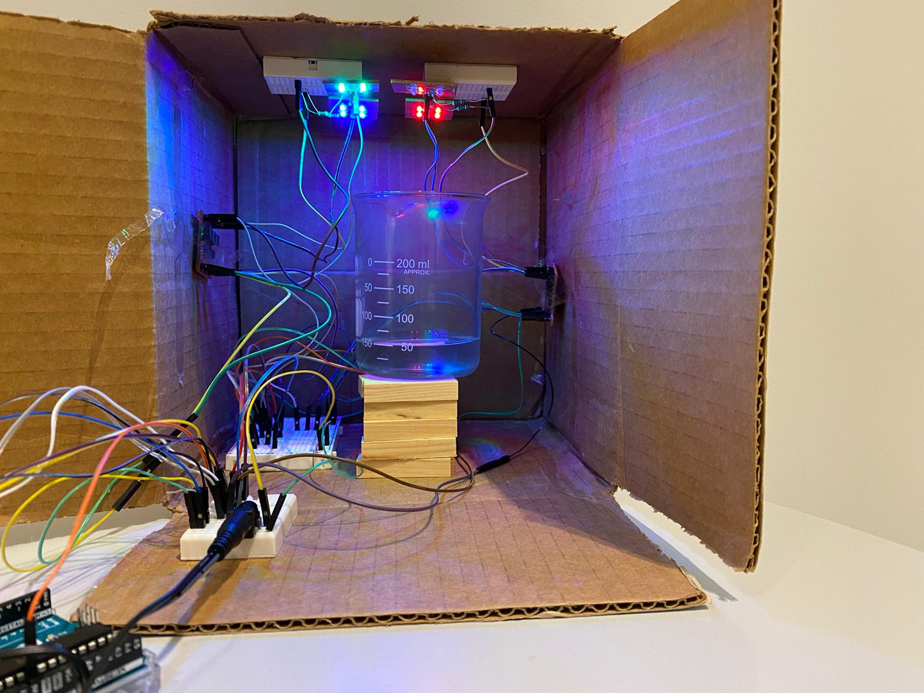
Implementation
Green LEDs
IR LEDs
Blue LEDs
Red LEDs
PicoBuck LED drivers
PicoBuck LED drivers
Beaker
Wooden Blocks
Breadboard
Arduino Uno Board
Connected to 12V power adapter
Notes:
The overall assembly of the system was organized in a cardboard box with the breadboards attached to the sides and top of the board.The material to be tested in added into the beaker.Each LED driver powers two panels of LEDs. This configuration was adopted due to the requirement of sufficient source of light for detection at the sensor placed at the bottom.These LED panels are connected through a 1kΩ resistor in series. The LED panels are placed on the top of the board.The Adafruit sensor uses serial communication to provide the readings for the signals. It is a multipurpose sensor, which can give Visible light measurement,in addition to Infrared signal strength. It also has the ability to provide a UV index based on the Visible light and IR signal strength. This sensor was placed at the bottom of the board on a pair of wooden blocks, with the beaker placed on top of it through the help of some additional blocks. This ensured two pathways to the sensor: line of sight signal and multi-path/diffracted signal. It also served to block light being reflected from the sides of the cardboard box.The entire setup was powered by a 12V power supply with the Arduino connected to the laptop to collect data serially.

Slide 9
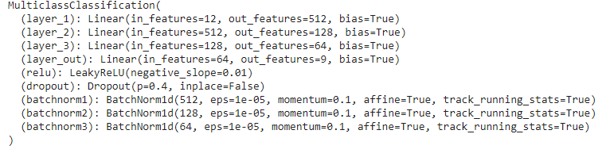
Neural Network details
3 layered multiclass classification
Notes:
The model that we trained for classification was a 3 layer neural network. This was trained with Adam optimizer, with a CrossEntropy Loss function. The loss function was weighted for each class based on the distribution of the class. The feature vectors for the model were the Visible, IR, & UV light for each of the 4 LED panels, thus making it a total of 12 Dimensional Feature Vector. An extensive set of experimentation was done for parameter tuning

Slide 10
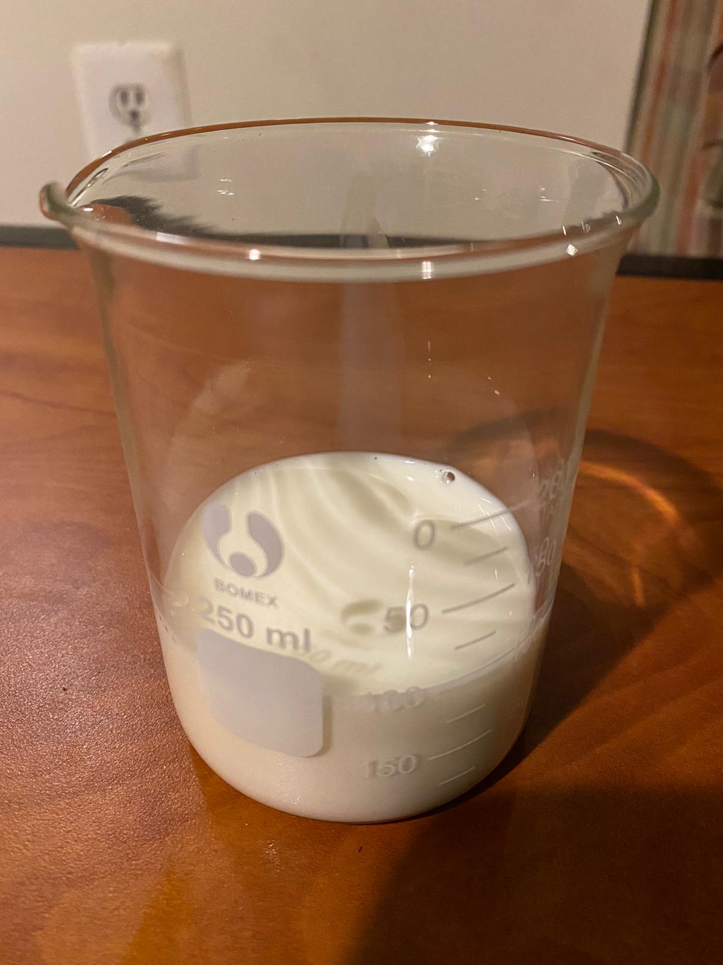
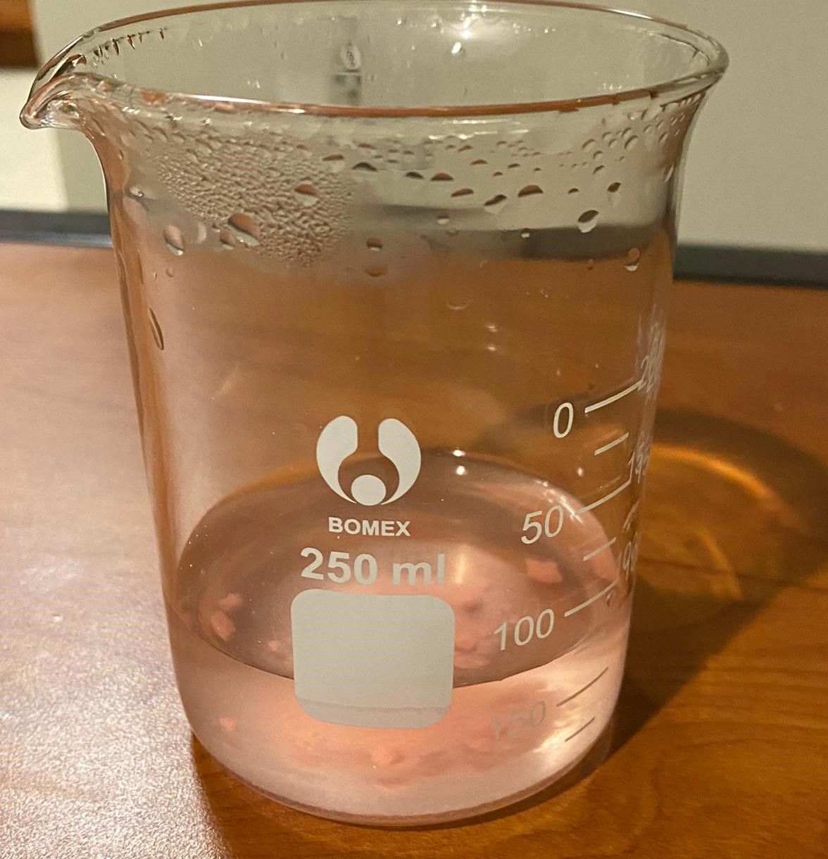
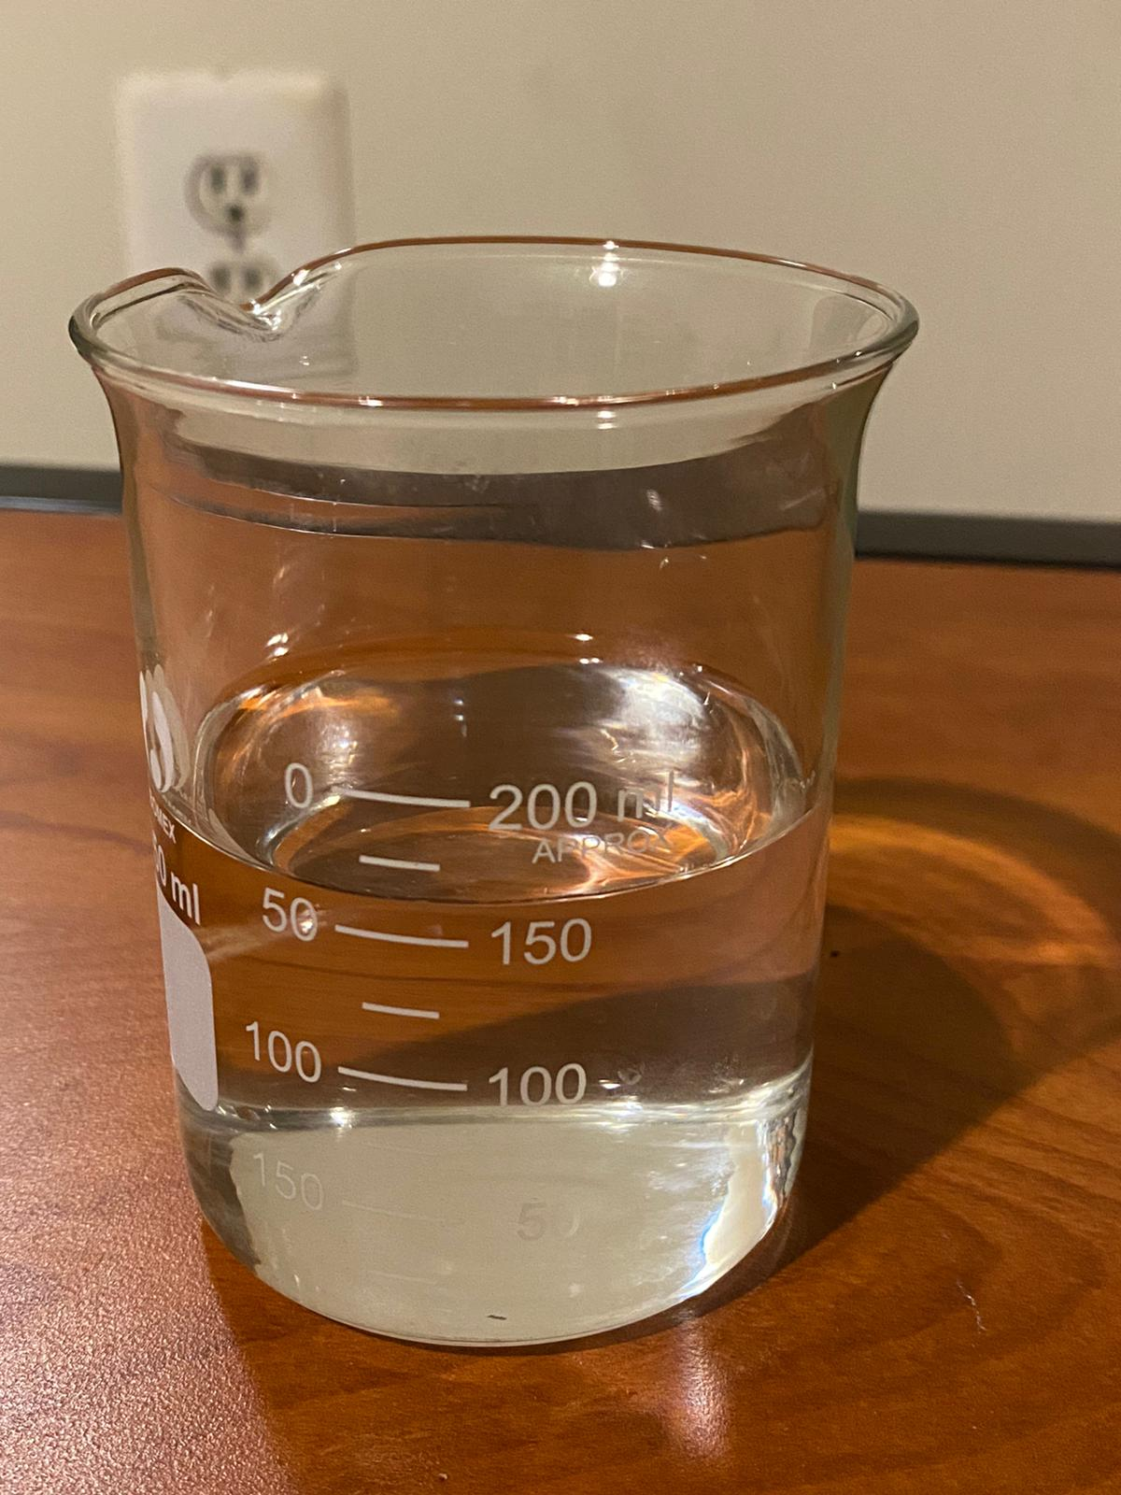
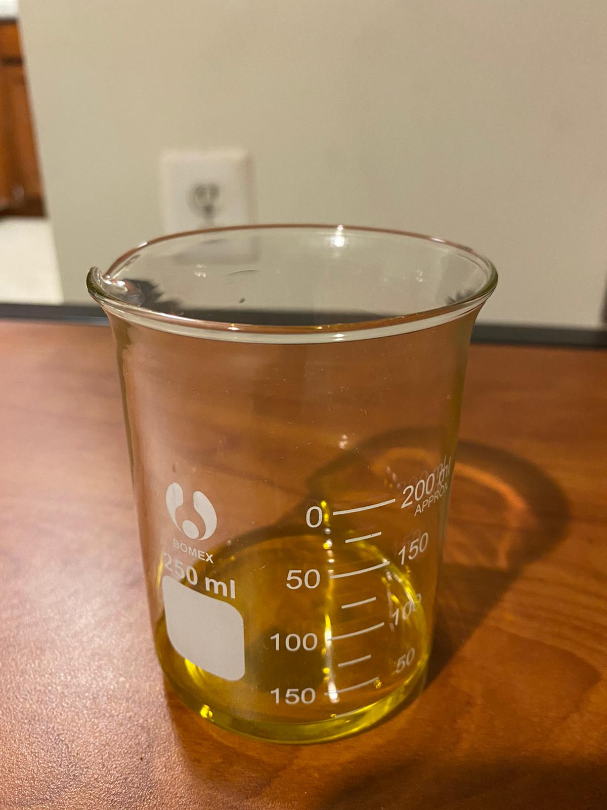
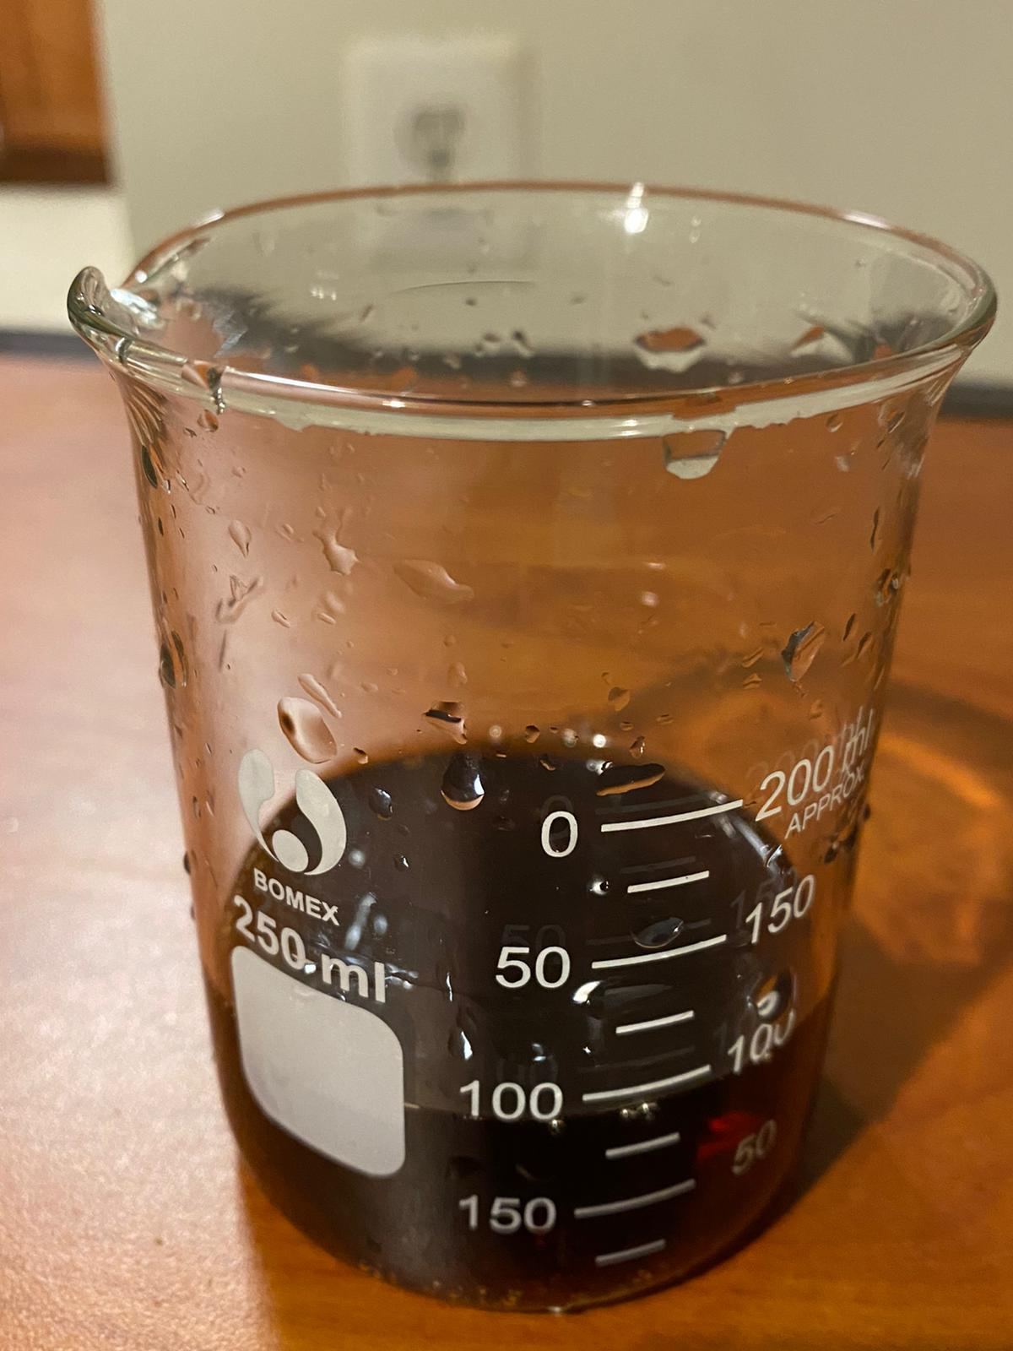
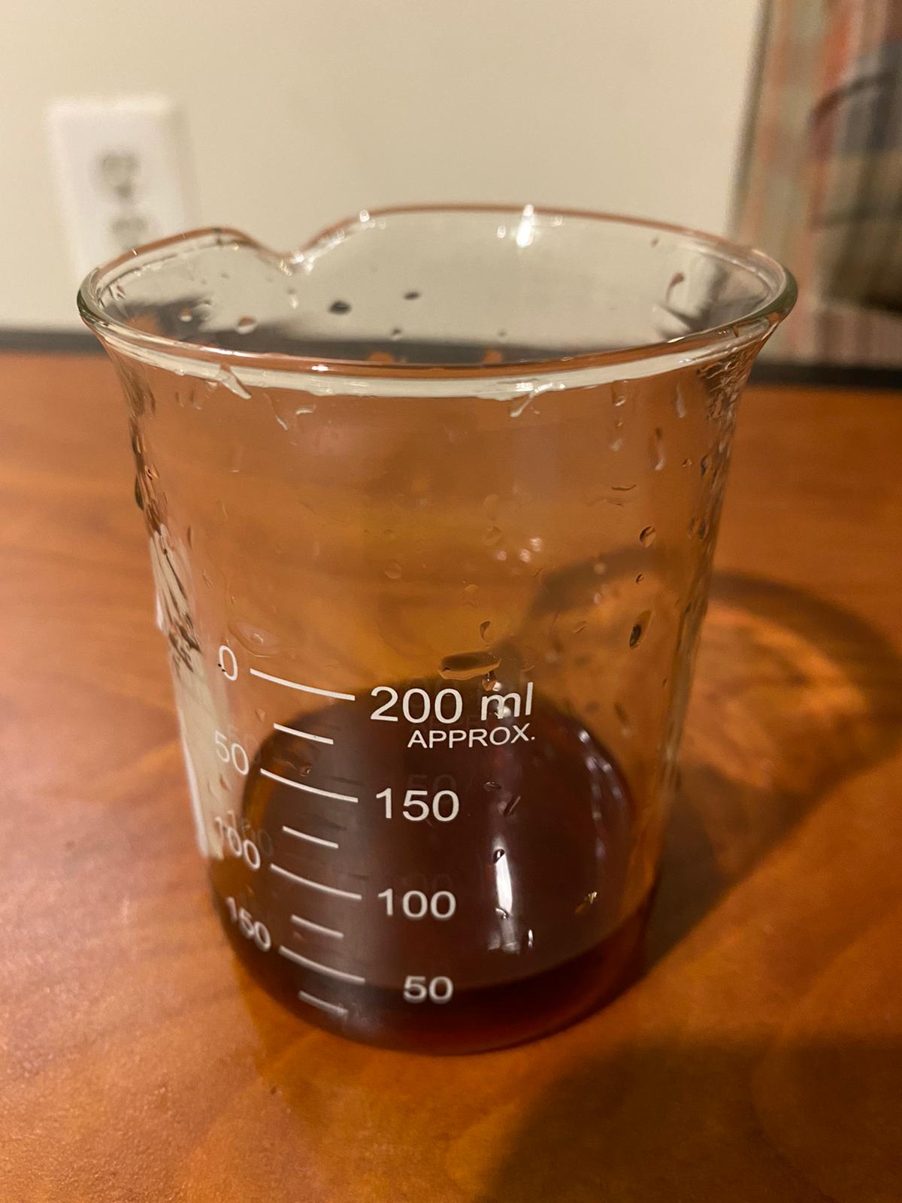
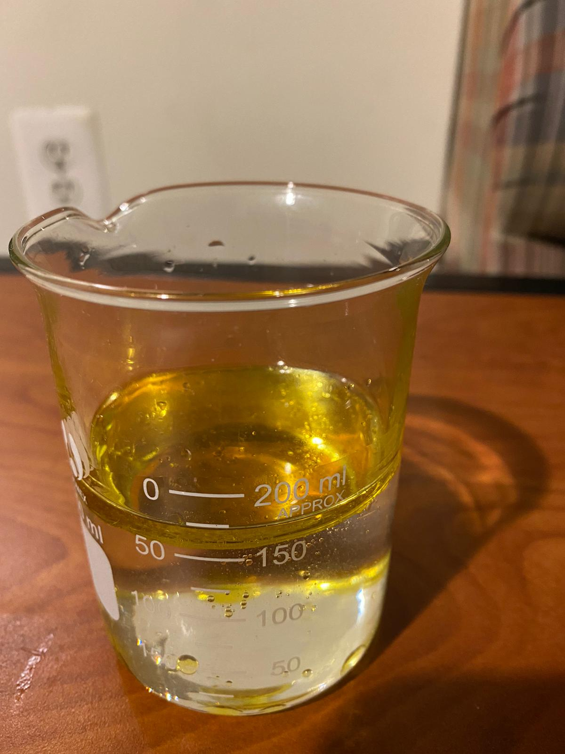
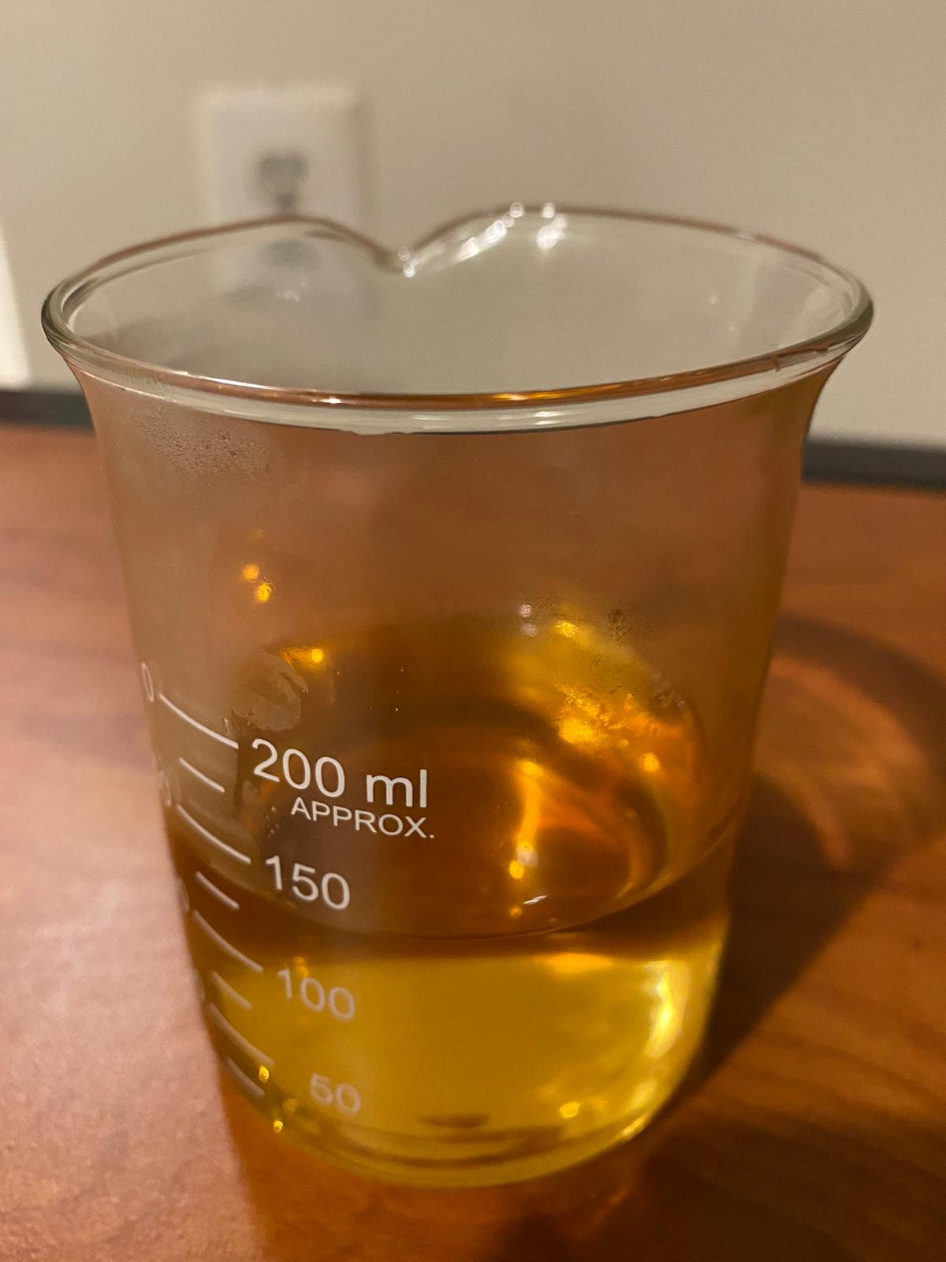
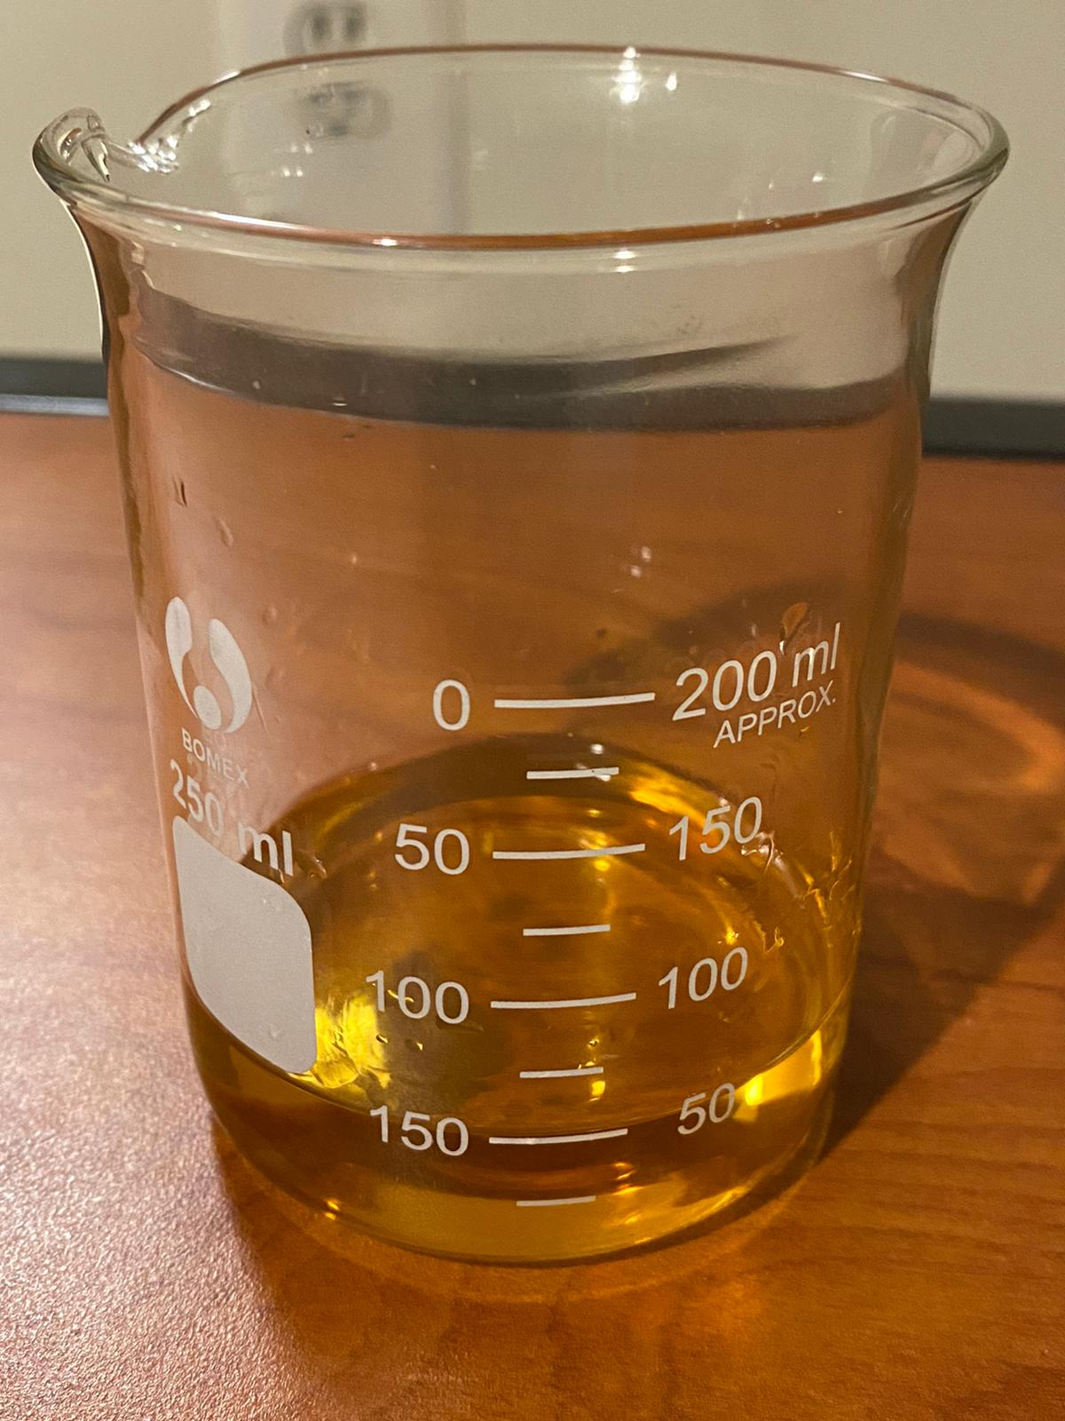
Materials tested
Milk
Water+Tablet
Water
Olive Oil
Soda(Pepsi)
Coffee
Alcohol
Water+Alcohol+Tablet
Olive Oil+Water

Slide 11
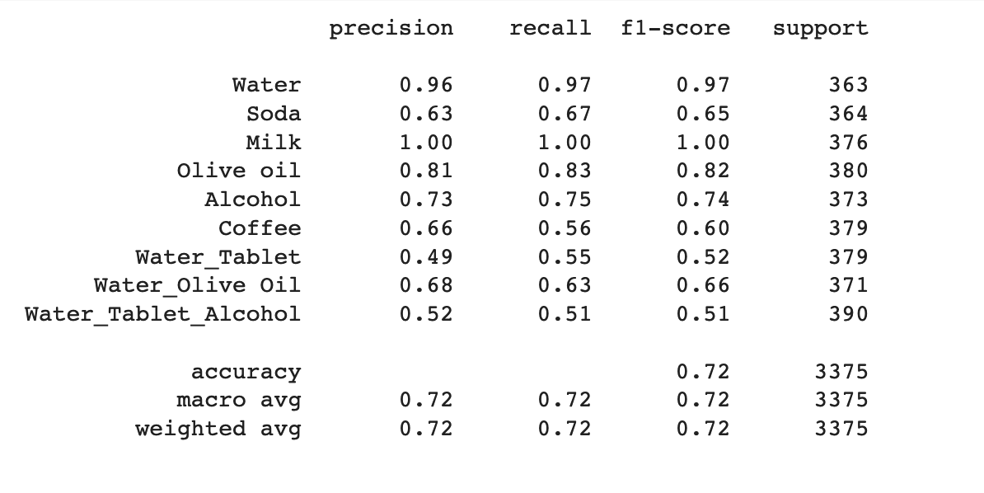
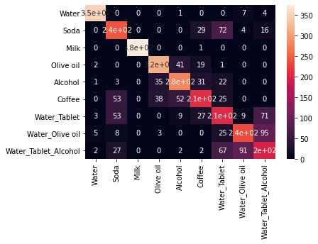
Results
Classification report
Confusion Matrix heatmap
Notes:
Here,we have our statistical results of the liquids we tested.We see that our approach was able to classify Water,Soda,Milk and Olive oil very accurately.Soda and Coffee had a few misclassifications due to ther similar spectral response..We evaluate the behavior and understand the effectiveness of our classifier through the Confusion Matrix heatmap. As you can see,most of the classifications are along the diagonal which shows that the system is able to differentiate between different liquid materials.

Slide 12
Conclusion
Our model’s accuracy is 72% overall, which we believe marks a significant progress towards building liquid categorization and adulteration detection.
Our system is low-cost compared to other existing solutions.
Our design decision for the hardware makes it portable.
Lastly, very less time and skill and skill are required for reproducing the setup.

Slide 13
Future Works
Adding more hardware components (more sensors and LED)
Moving over from sequential LED firing order to multiple LED firing at the same time.
Modifying the placement schemes of the sensors and LED panels to reduce refraction errors.
Notes:
Increasing the number of sensors for reception of LED signals to have refined and more accurate measurements.Adding more LED’s of different wavelength to get a more feature rich set of data points to train the network . Another possible modification can be changing the way of LEDs flashing. Currently, we are following a sequential firing order of LEDs from a single wavelength panel and then passing them through the liquid. For future work, instead of sequential order, the system can take multiple wavelength LEDs turned on at the same time. This may help to provide additional features for neural network training.Further,we could modify the placement of sensors and LED panels to reduce refraction errors in our setup as well.

Slide 14
References
Dhekne, A., Gowda, M., Zhao, Y.,Hassanieh, H., and Choudhury, R. R.Liquid:A wireless liquid identifier. In Proceedings of the16th Annual International Conference on MobileSystems, Applications, and Services(New York,NY, USA, 2018), MobiSys ’18, Association for Computing Machinery, p. 442–454.
Ha, U., Leng, J., Khaddaj, A., and Adib, F.Food and liquid sensing in practical environments using rfids. In17th USENIX Symposium on Networked Systems Design and Implementation(NSDI 20)(Santa Clara, CA, Feb. 2020), USENIX Association, pp. 1083–1100.
Rahman, T., Adams, A. T., Schein, P., Jain,A., Erickson, D., and Choudhury, T.Nutrilyzer: A mobile system for characterizing liquid food with photoacoustic effect. InProceedings of the 14th ACM Conference on Embedded Network Sensor Systems CD-ROM(New York, NY, USA, 2016), SenSys ’16,Association for Computing Machinery, p. 123–136

Slide 15
Thank you

